Slide 1
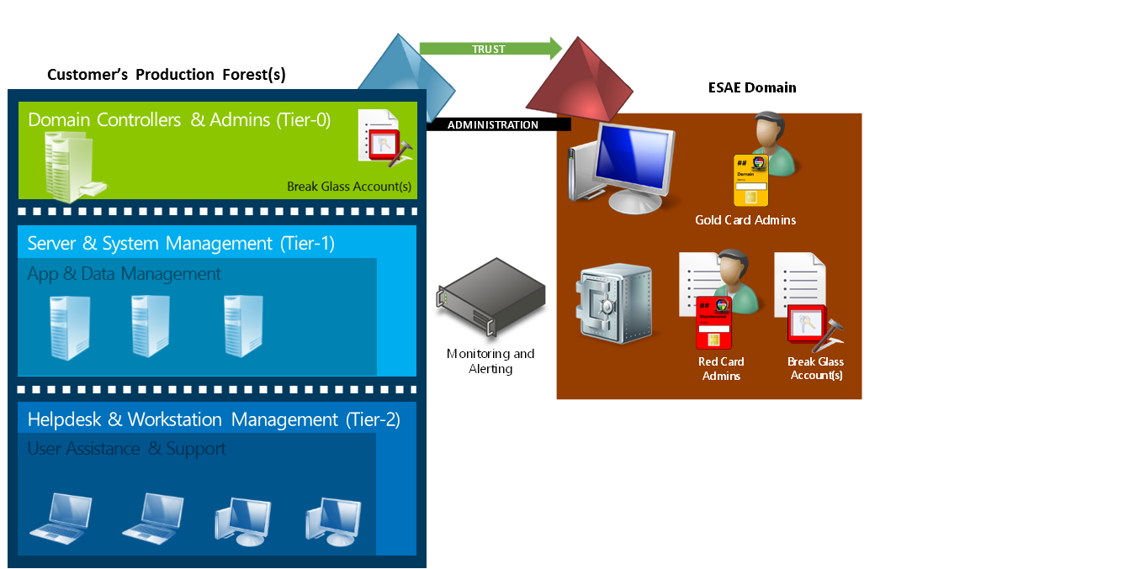
Module 3 Enhanced Security Administrative Forest
Section 4 - Deploy an Enhanced Security Administrative Environment
June 2018

Slide 2
Agenda
01
Introduction and architecture An overview of the different components of ESAE.
02
Hardware and network requirements The list of requirements to successfully deploy a secure an Enhanced Security Administrative Forest.
03
User roles and smartcards Review of the different user roles in the ESAE forest.
04
Managing the bastion forest Review of the additional components to manage an ESAE forest.

Slide 3
Bringing everything together
This section brings all security practices we have seen together
Unlike the other sections which look at the theory behind the secure approach, this section emphasizes on the deployment steps
Enhanced Security Administrative Environment…
Is based on the credential partitioning on tiers model
Is a dedicated forest for administration
Uses dedicated administrative accounts on dedicated administrative workstations (see module 3 section 2 for details)
Uses separate user accounts for administration
Enforces smartcard for authentication
Includes the deployment of a dedicated certification authority
Uses a dedicated deployment and patching (WSUS) infrastructure
Notes:
This section is all about bringing together all the concepts we have seen.
ESAE is a Microsoft Consulting offering that organizations can buy. In that case, Microsoft Services comes onsite and takes care of the installation and configuration. However, it is also possible to achieve the same results without engaging Microsoft Services as long as the organizations have the time and the resources (hardware and skillset) to achieve similar outcomes.
WSUS Windows Server Update Services enables information technology administrators to deploy the latest Microsoft product updates. You can use WSUS to fully manage the distribution of updates that are released through Microsoft Update to computers on your network. This is a free feature.
Ref: https://docs.microsoft.com/en-us/windows-server/administration/windows-server-update-services/get-started/windows-server-update-services-wsus

Slide 4
Bastion forest
Single ESAE domain with minimal maintenance and exposure
Self-maintaining (to the extent possible)
Windows Server Update Services (WSUS) patches secure forest automatically
Small footprint
Two domain controllers
Management servers and virtual machines
High-security Kerberos and NTLM settings for domain
Smart card enforcement for all user roles

Slide 5
Professor Useful
What name for the bastion forest?
Should not use “ESAE” or a term that can be linked to these solution documents on the Internet
Recommend an innocuous name that doesn’t indicate the purpose of the environment
Intended to slow down attackers
Will not stop them or constitute a significant security barrier, as once the AD Trust is created the name is visible in the managed forest
Avoid .local as the DNS suffix
Notes:
Note that IPv6 uses .local for Multicast DNS resolution for link-local addresses (RFC 6762). Apple systems also use this for their Bonjour mDNS and will fail to resolve.

Slide 6
Dedicated administrative forest overview
Notes:
Note that this section does not go into detail of PAW since this has been covered in module 3 section 2.

Slide 7
OS and hardware requirements
Windows 10 Enterprise or Windows Server 2016
x64 architecture
UEFI firmware version 2.3.1 or higher and Secure Boot
Secure firmware update process
Trusted Platform Module version 1.2 or 2.0
BitLocker
Smartcard readers on PAW machines
Notes:
To verify that the firmware complies with the secure firmware update process, you can validate it against the System.Fundamentals.Firmware.UEFISecureBoot Windows Hardware Compatibility Program requirement. Credential Guard relies on the security of the underlying hardware and firmware. It is critical to keep the firmware updated with the latest security fixes.
Ref: https://technet.microsoft.com/itpro/windows/keep-secure/credential-guard

Slide 8
Virtualization requirements
Use of a dedicated Hyper-V farm strongly recommended
System hardening already designed and implemented in ESAE
Virtualization platform can be managed by ESAE (domain-joined)
Automatically updated via WSUS
Storage should be local, but if on a SAN the shared volume must be Bitlocker encrypted
If another virtualization platform is selected, local storage is required
Notes:
Isolates ESAE from the rest of the environment!
If a third-party virtualization platform is used (e.g. VMware):
The AD admins should solely manage the servers, or
A subset of virtualization admins will need to be issued ESAE admin workstations, smart cards, etc.
Must be considered Red Card equivalents
If Virtual Center is desired, a dedicated instance must be used for ESAE

Slide 9
Network hardening
Help protect Red Forest domain members from any network threat in a customer network or network isolation
Safeguarded by design and by default built offline in a security-enhanced lab
Domain controllers require IPsec inbound and outbound
Domain members require IPsec inbound and outbound
IPsec rules provide exceptions in and out
Block all unplanned traffic in and out of the ESAE environment
IPsec for authenticating and encrypting traffic within ESAE
Block all Internet connectivity from ESAE
Exception: WSUS to Windows Update or upstream WSUS
Isolate servers from the production network during build
Notes:
Note that if IPSec is planned to be used between the production forest and the ESAE forest, it will require to create security association rules in the productions domain controllers.
Note that the ESAE forest should host its own DNS zone (forwarders are used for cross-forest name resolution).

Slide 10
ESAE User roles
ESAE users and admins are all using smartcard authentication
There are at least four roles to implement
ESAE Maintenance Role (red card)
Production AD Administrator Role (gold card)
ESAE Auditor Role (white card)
ESAE Emergency Maintenance Role (break glass)

Slide 11
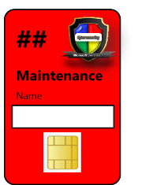
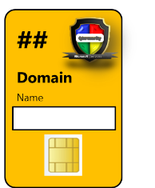
ESAE User Roles
ESAE Maintenance Role (red card)
Domain Administrators in the ESAE forest
No permissions in the production domains
Use a smartcard to log on to the administrative workstations
Can log on only to ESAE workstations and servers
Production AD Administrator Role (gold card)
Domain Administrators in the respective production domain
Normal users in the ESAE forest
Use a smartcard to log on to the administrative workstations
Can only log on to the hardened administrative workstations and physical production domain controllers

Slide 12
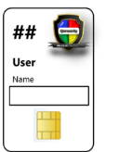

ESAE User Roles
ESAE Auditor Role (white card)
Use a smartcard to log on to the administrative workstations
Can only log on to the hardened administrative workstations
ESAE Emergency Maintenance Role (break glass)
Domain Administrator in ESAE
Do not use a smartcard to log on
The user name and password are stored in a safe. The password is changed after every use
Can only log on physically to domain controllers
Used only for initial forest configuration and in emergency situations

Slide 13
Certification Authority requirements
The ESEA CA will be responsible for issuing:
Smartcard certificates for users
Certificates for server authentication if needed (TLS webservices, LDAPs)
Certificates for IPSec communications
Notes:
You also need to establish processes for control of small physical objects such as:
Envelope with password tracking sheet
Smart card handling
Envelope with smartcard PIN

Slide 14
Update management & Monitoring
A dedicated WSUS infrastructure to manage updates
ESAE machines’ updates
Production DCs updates can also be in scope
Patch trigger mechanism
WSUS rules to govern reboot timing (Monday, Wednesday, and Friday apply and reboot groups)
You can use monitoring solutions
But do no install agents in production which initiate connections to ESEA components

Slide 15
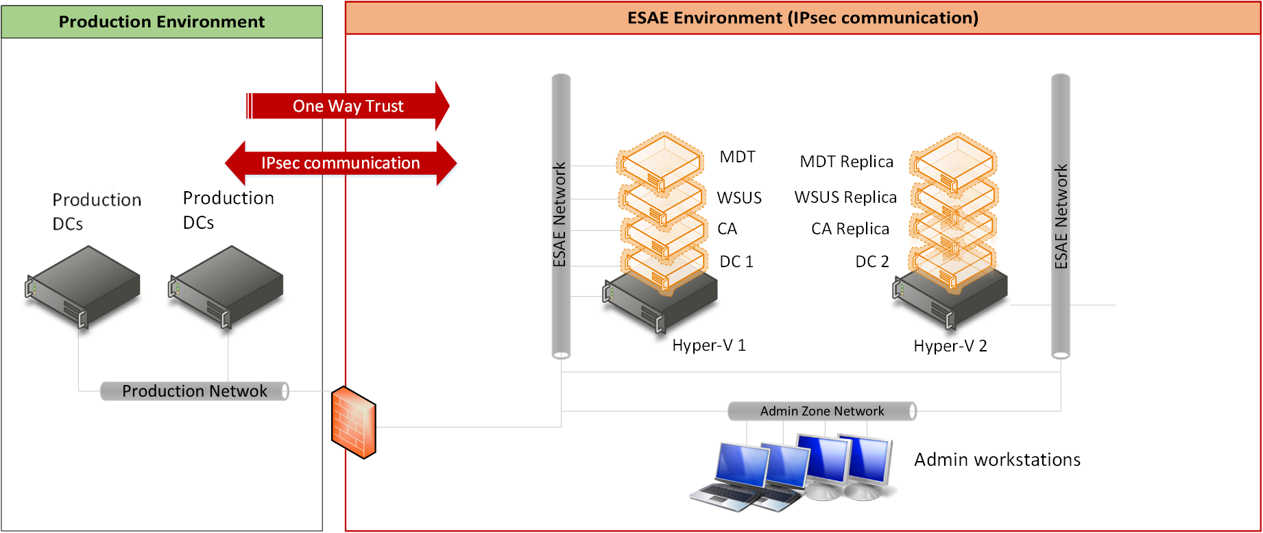
General overview
Notes:
Note that the MDT server is used to build secure PAW machines (see module 3 section 2).

Slide 16
Backup management
ESAE environment is not “uptime” critical
Clients can administer production domain controllers even when ESAE servers are not online
If a PAW client is broken, issue a rebuilt from the MDT server
Domain controllers are redundant
Existing Windows Backup tools can be used
Make sure the storage is physically secured and encrypted
Notes:
Usually the backup deployment is not part of standard ESAE deployment when delivered by Microsoft Services. Nevertheless, this should also be considered even if the ESEA is not uptime critical.

Slide 18
List of abbreviations
ESAE Enhanced Security Administrative Forest
CA Certification/Certificate Authority

